Slide 2

Baseball
Batting Average
$BA$ = $\frac{hits}{bats}$ = $\frac{H}{AB}$
0.266
Notes:
Today, let’s talk about baseball
There is a term called Batting average in baseball. It is used to measure how excellent a baseball player is.
It’s the number of hits divided by at bats.
>0.3 excellent

Slide 3
Choose who?
Name | H | AB | average
Harry Atkinson | 2 | 5 | 0.400
Hank Aaron | 3771 | 12364 | 0.305
Notes:
Image you are a baseball recruiter trying to find some players with good performances in the batting averages. Are you going to choose Hank Aaron with a BA at 0.400 or Harry Atkinson with a BA at 0.305? I bet almost everyone will choose Hank Aaron because the high BA of Hank might be due to luck. Hank, on the other hand, has a lot of evidence that he’s an high-average batter.

Slide 4
Batting Average analysis in Baseball
by Bayesian Analysis
Yaowei Li
Mingjie Ye
December 9, 2019

Slide 5

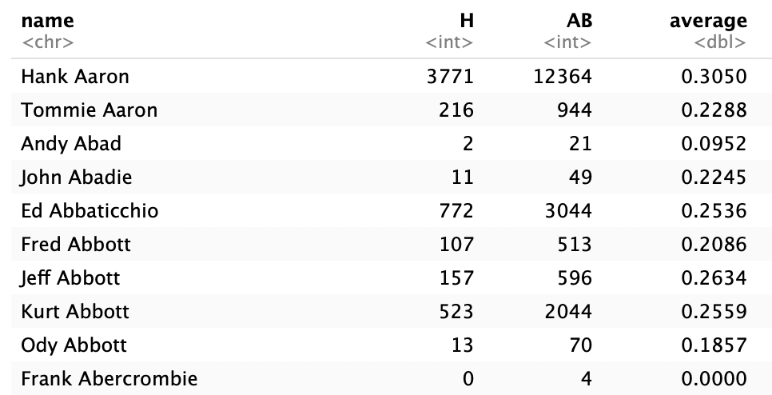
Dataset
Lahman: Sean 'Lahman' Baseball Database
pitching, hitting and fielding performance
from 1871 through 2018

Slide 6
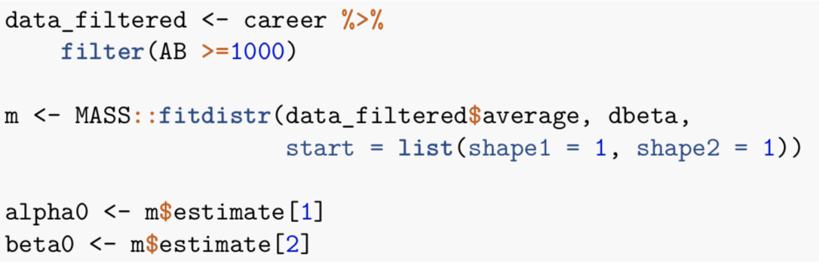
Model 1: Empirical Bayes estimation
Beta distribution ~ Conjugate prior for the Binomial distribution
Prior distribution is estimated from the data
Calculate from the mean and variance of the batting average in the dataset
Maximum-Likelihood Fitting
Notes:
Beta distribution is a conjugate prior for the Binomial distribution.
Filter

Slide 7
Model 1: Empirical Bayes estimation
alpha0 = 96.83, beta0 = 270.19
Notes:
Filter

Slide 8
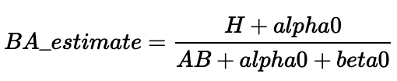
Model 1: Empirical Bayes estimation
alpha0 = 96.83, beta0 = 270.19
Name | H | AB | average | BA estimate
Harry Atkinson | 2 | 5 | 0.400 | 0.266
Hank Aaron | 3771 | 12364 | 0.305 | 0.304
Notes:
Filter

Slide 9
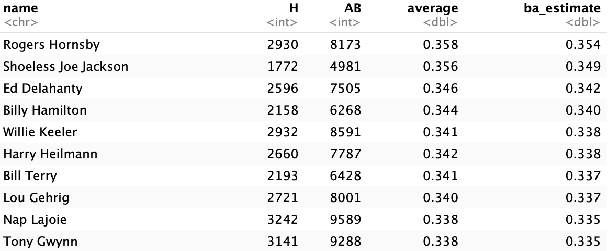
Model 1: Empirical Bayes estimation
Notes:
Filter

Slide 10
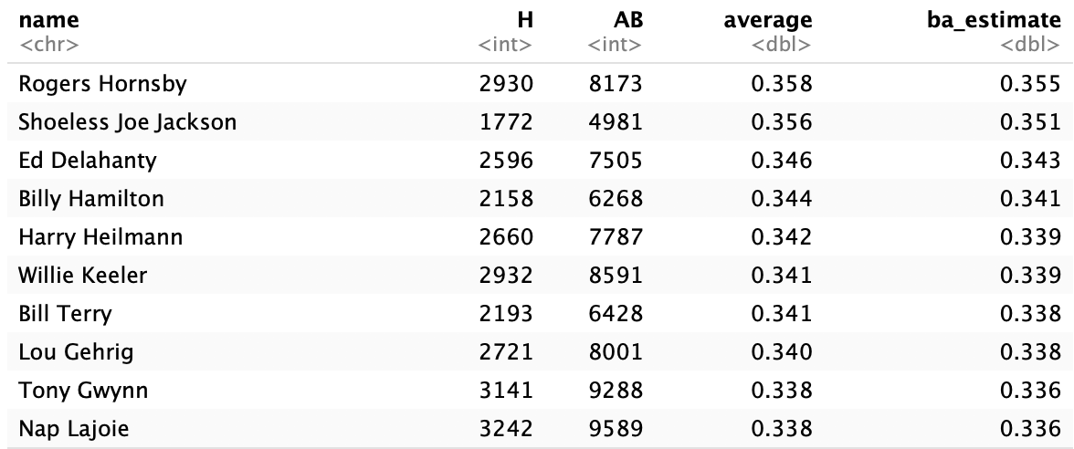
Model 2: Standard Bayes Method
alpha=81
beta=219
around 0.266
from 0.21 to 0.35
Notes:
Filter

Slide 11
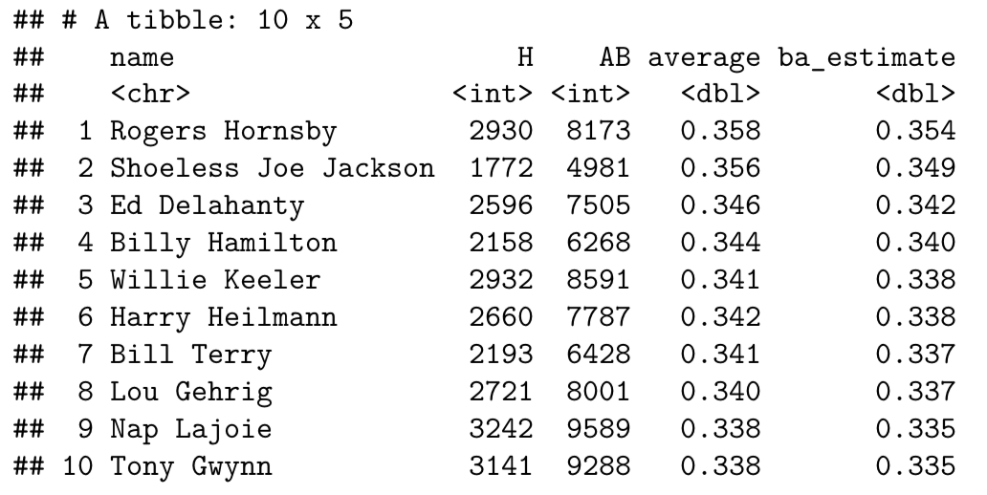
Model 3: Pooled Model
alpha=96.58
beta=269.79
Notes:
Result does not change a lot.
The first one
And the top 10 ba_estimate is from 0.335-0.354

Slide 12
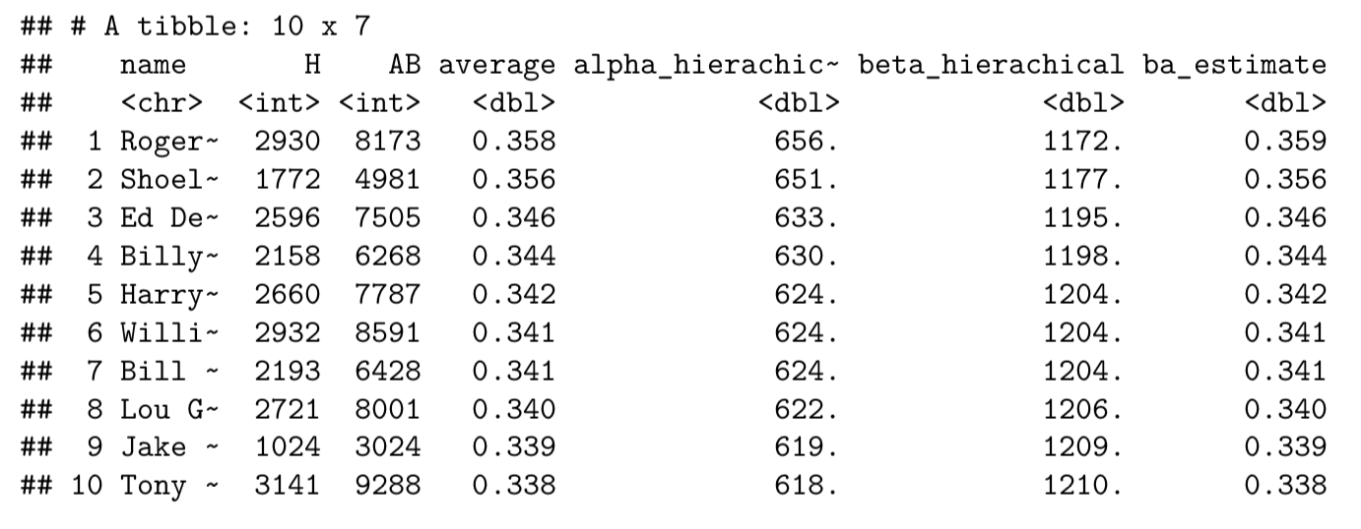
Model 4: Hierarchical model
Notes:
The result of hierarchical model is still similar to others.
The estimation of alpha and beta is different. Alpha: around 600. Beta: around 1200.
The ba_estimate is still similar to others.

Slide 13
Convergence and sensitivity: Pool Model
 | Rhat | ESS
alpha | 1 | 1395
beta | 1 | 1409
Notes:
Rhat here are all 1 which means we can believe the model converges well.
Effective sample size of alpha and beta are larger than 100 (approximately) indicate that estimates of posterior are reliable.

Slide 14
Convergence and sensitivity: Hierarchical Model
 | Rhat | ESS
alpha | 0.99 | 14408
beta | 0.99 | 14408
Notes:
Here also:
Rhat here are all 1 which means we can believe the model converges well.
Effective sample size of alpha and beta are larger than 100 (approximately) indicate that estimates of posterior are reliable.

Slide 15
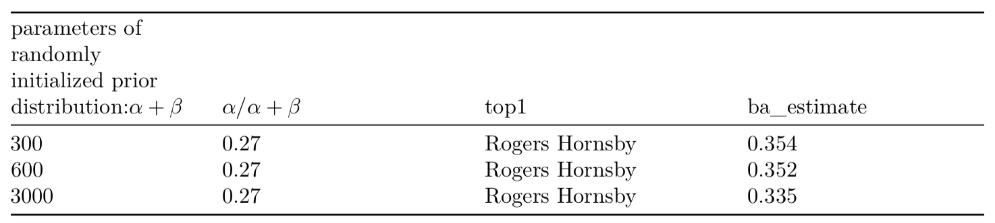
Sensitivity Analysis: Randomly Initialized Model
Notes:
The sensitivity of posterior to the proposed prior distribution is exhibited in Table.
The first column is the parameter of the prior distribution α + β.
The second column is the mean of prior distribution, which is calculated by α/α + β.
Here we fixed the mean of prior distribution.
Thus, the amount of prior information is measured by α+β. Posterior inferences are not particularly sensitive to the prior distribution.
From the table we can deduce that, hierachical model is the most stabel one of the three models we used. Since its order is most stable and the BA estimations of the top 1 is also most stable.

Slide 16
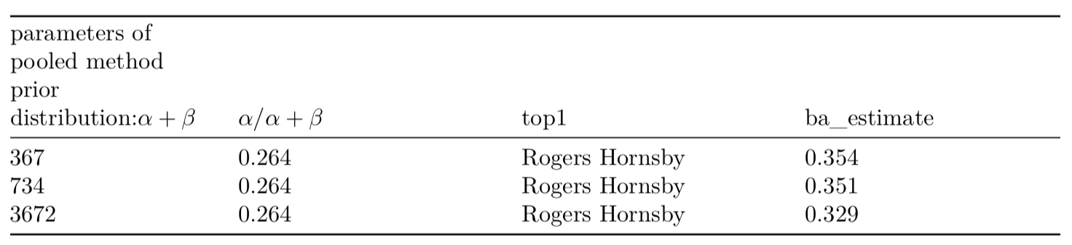
Sensitivity Analysis: Pool Model
Notes:
Posterior inferences are not particularly sensitive to the prior distribution.

Slide 17
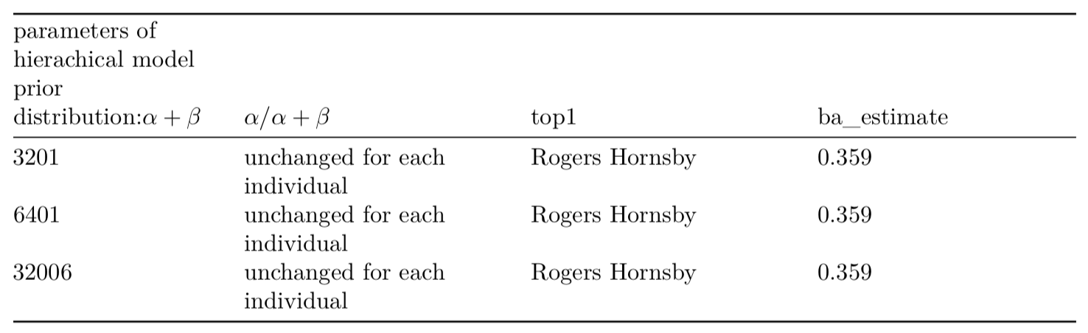
Sensitivity Analysis: Hierarchical Model
Notes:
Posterior inferences are not particularly sensitive to the prior distribution.
From the table we can deduce that, hierachical model is the most stabel one of the three models we used. Since its order is most stable and the BA estimations of the top 1 is also most stable.

Slide 18
Discussion and Conclusion
compare the different model, the top ten players selected by different models are similar.
The hierachical mode can provide a more stable result, with nearly unchanged order when we increase α + β.
in the dataset, each person only have one data point of average. This will lead to the fact that the simulated ba_estimate is quite similar to the average of each person. Therefore, we hope to get more average data of each person to further improve this model.

Slide 19
Thanks!

